Slide 1

CHAPTER 4
ELEMENTARY NUMBER THEORY AND METHODS OF PROOF
Copyright © Cengage Learning. All rights reserved.

Slide 2

4.1
Direct Proof and Counterexample Ⅰ: Introduction
Copyright © Cengage Learning. All rights reserved.

Slide 3
Direct Proof and Counterexample Ⅰ: Introduction
Both discovery and proof are integral parts of problem solving. When you think you have discovered that a certain statement is true, try to figure out why it is true. If you succeed, you will know that your discovery is genuine.
Even if you fail, the process of trying will give you insight into the nature of the problem and may lead you to discover that the statement is false. For complex problems, the interplay between discovery and proof is not reserved to the end of the problem-solving process but, rather, is an important part of each step.

Slide 4
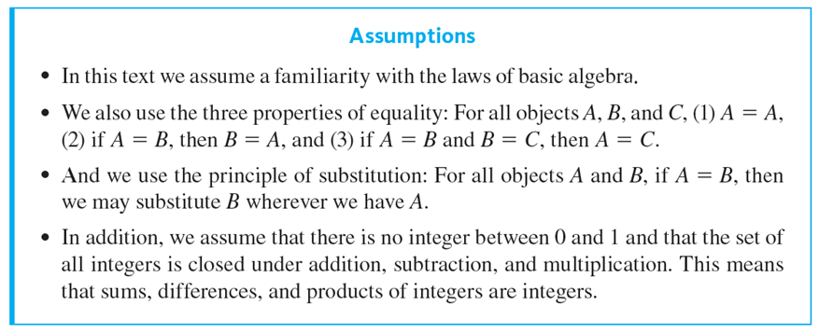
Direct Proof and Counterexample Ⅰ: Introduction

Slide 5
Even, Odd, Prime, and Composite Integers

Slide 6
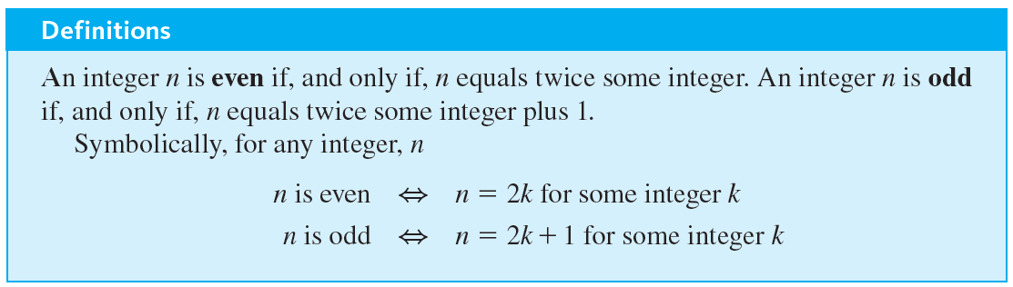
Even, Odd, Prime, and Composite Integers

Slide 7

Example 4.1.1 – Even and Odd Integers
Use the definitions of even and odd to justify your answers to the following questions.
a. Is 0 even?
b. Is −301 odd?
c. If a and b are integers, is
even?
d. If a and b are integers, is 10a + 8b + 1 odd?
e. Is every integer either even or odd?

Slide 8


Example 4.1.1 – Solution
a. Yes, 0 is even because 0 = 2 · 0.
b. Yes, −301 is odd because −301 = 2(−151) + 1 and −151 is an integer.
c. Yes,
is an integer since it is a product of integers.
d. Yes, 10a + 8b + 1 is odd because
10a + 8b + 1 = 2(5a + 4b) + 1 and 5a + 4b is an integer since it is a sum of products of integers.
is even because

Slide 9
Example 4.1.1 – Solution
continued
e. Yes, every integer is either even or odd. However, the reason for this fact is not immediately apparent. It can be deduced using the method of proof by contradiction. It is also a consequence of the quotient-remainder theorem.

Slide 10
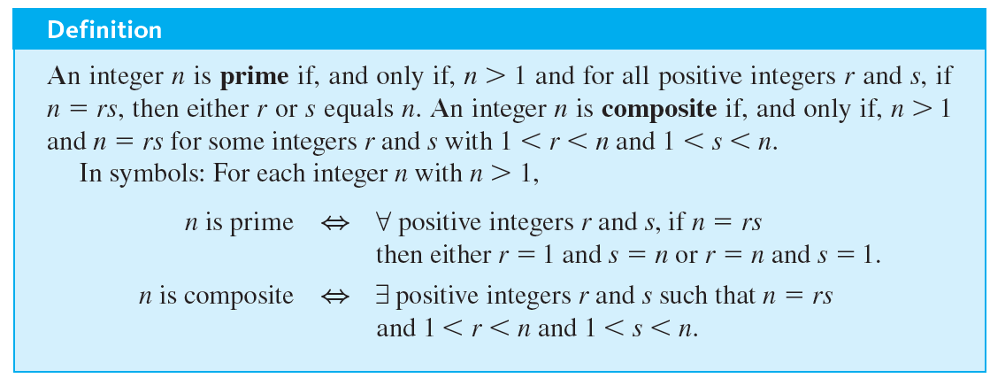
Even, Odd, Prime, and Composite Integers

Slide 11
Example 4.1.2 – Prime and Composite Numbers
a. Is 1 prime?
b. Is every integer greater than 1 either prime or composite?
c. Write the first six prime numbers.
d. Write the first six composite numbers.

Slide 12
Example 4.1.2 – Solution
a. No. A prime number is required to be greater than 1.
b. Yes. Let n be any integer that is greater than 1. Consider all pairs of positive integers r and s such that n = rs. There exist at least two such pairs, namely, r = n and s = 1 and r = 1 and s = n. Moreover, since n = rs, all such pairs satisfy the inequalities 1 ≤ r ≤ n and 1 ≤ s ≤ n.

Slide 13
Example 4.1.2 – Solution
continued
If n is prime, then these two pairs are the only ways to write n as rs. Otherwise, there exists a pair of positive integers r and s such that n = rs and neither r nor s equals either 1 or n. Therefore, in this case 1 < r < n and 1 < s < n, and hence n is composite.
c. 2, 3, 5, 7, 11, 13
d. 4, 6, 8, 9, 10, 12

Slide 14
Example 4.1.2 – Solution
continued
c. 2, 3, 5, 7, 11, 13
d. 4, 6, 8, 9, 10, 12

Slide 15
Proving Existential Statements

Slide 16
Proving Existential Statements
According to the definition, a statement in the form
∃x ∈ D such that Q(x)
is true if, and only if,
Q(x) is true for at least one x in D.
One way to prove this is to find an x in D that makes Q(x) true. Another way is to give a set of directions for finding such an x. Both of these methods are called constructive proofs of existence. The logical principle underlying such a proof is called existential generalization.

Slide 17
Proving Existential Statements
It says that if you know a certain property is true for a particular object, then you may conclude that “there exists an object for which the property is true.”

Slide 18
Example 4.1.3 – Constructive Proofs of Existence
a. Prove: ∃ an even integer n that can be written in two ways as a sum of two prime numbers.
b. Suppose that r and s are integers. Prove: ∃ an integer k such that 22r + 18s = 2k.

Slide 19
Example 4.1.3 – Solution
a. Let n = 10. Then 10 = 5 + 5 = 3 + 7 and 3, 5, and 7 are all prime numbers. Thus ∃ an even integer—namely, 10—that can be written in two ways as a sum of two prime numbers.
b. Let k = 11r + 9s. Then k is an integer because it is a sum of products of integers, and by substitution, and the distributive law of algebra,
2k = 2(11r + 9s) = 22r + 18s.
Thus ∃ an integer, namely k, such that 22r + 18s = 2k.

Slide 20
Proving Existential Statements
A nonconstructive proof of existence involves showing either (a) that the existence of a value of x that makes Q(x) true is guaranteed by an axiom or a previously proved theorem or (b) that the assumption that there is no such x leads to a contradiction.
The disadvantage of a nonconstructive proof is that it may give virtually no clue about where or how x may be found. The widespread use of digital computers in recent years has led to some dissatisfaction with this aspect of nonconstructive proofs and to increased efforts to produce constructive proofs containing directions for computer calculation of the quantity in question.

Slide 21
Disproving Universal Statements by Counterexample

Slide 22
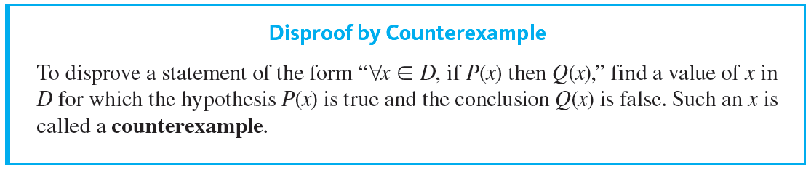
Disproving Universal Statements by Counterexample

Slide 23

Example 4.1.4 – Disproof by Counterexample
Disprove the following statement by finding a counterexample:
∀ real numbers a and b, if

Slide 24

Example 4.1.4 – Solution
To disprove this statement, you need to find real numbers a and b such that the hypothesis
is true and the conclusion a = b is false.
The fact that both positive and negative integers have positive squares helps in the search.
If you flip through some possibilities in your mind, you will quickly see that 1 and −1 will work (or 2 and −2, or 0.5 and −0.5, and so forth). You only need one such pair to give a counterexample.

Slide 25
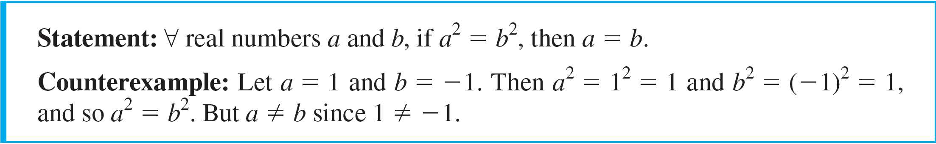
Disproving Universal Statements by Counterexample

Slide 26
Proving Universal Statements

Slide 27
Example 4.1.5 – The Method of Exhaustion
Use the method of exhaustion to prove the following statement:
∀n ∈ Z, if n is even and 4 ≤ n ≤ 26 then n can be written as a sum of two prime numbers.

Slide 28
Example 4.1.5 – Solution
4 = 2 + 2 6 = 3 + 3 8 = 3 + 5 10 = 5 + 5
12 = 5 + 7 14 = 11 + 3 16 = 5 + 11 18 = 7 + 11
20 = 7 + 13 22 = 5 + 17 24 = 5 + 19 26 = 7 + 19

Slide 29
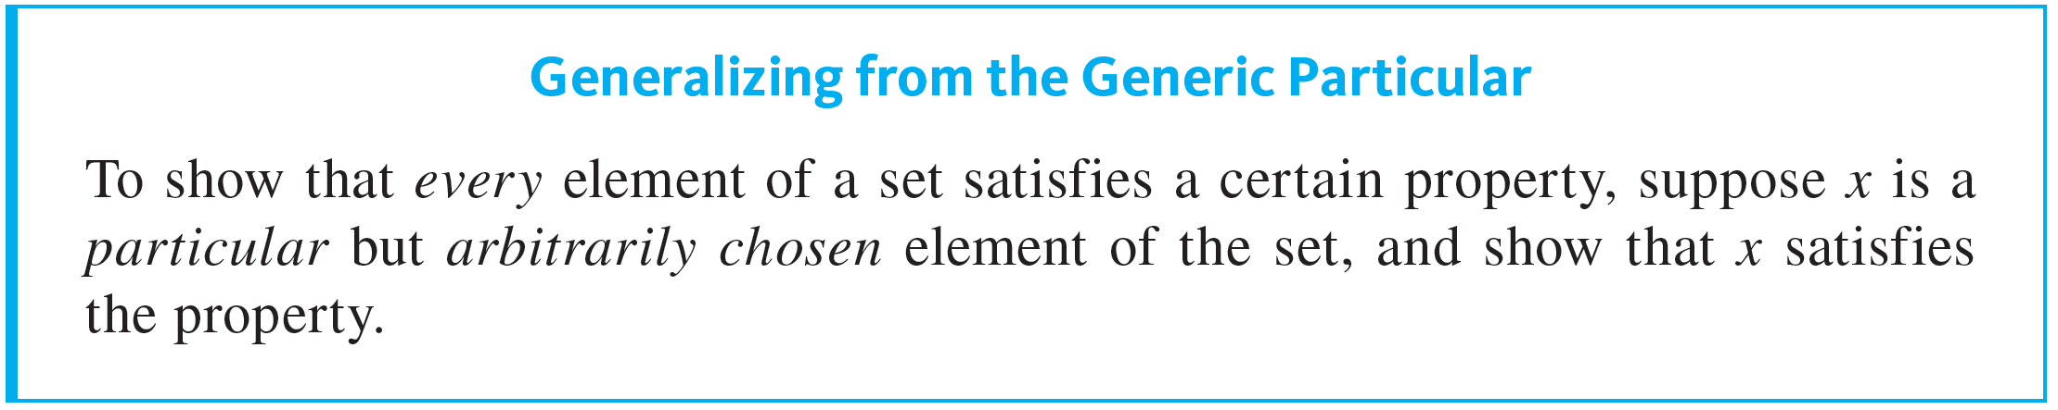
Proving Universal Statements
The most powerful technique for proving a universal statement is one that works regardless of the size of the domain over which the statement is quantified.
It is based on a logical principle sometimes called universal generalization. A more descriptive name is generalizing from the generic particular.

Slide 30

Example 4.1.6 – Generalizing from the Generic Particular
At some time you may have been shown a “mathematical trick” like the following. You ask a person to pick any number, add 5, multiply by 4, subtract 6, divide by 2, and subtract twice the original number.
Then you astound the person by announcing that their final result was 7. How does this “trick” work? Imagine that the empty box
contains whatever number the person picked.

Slide 31
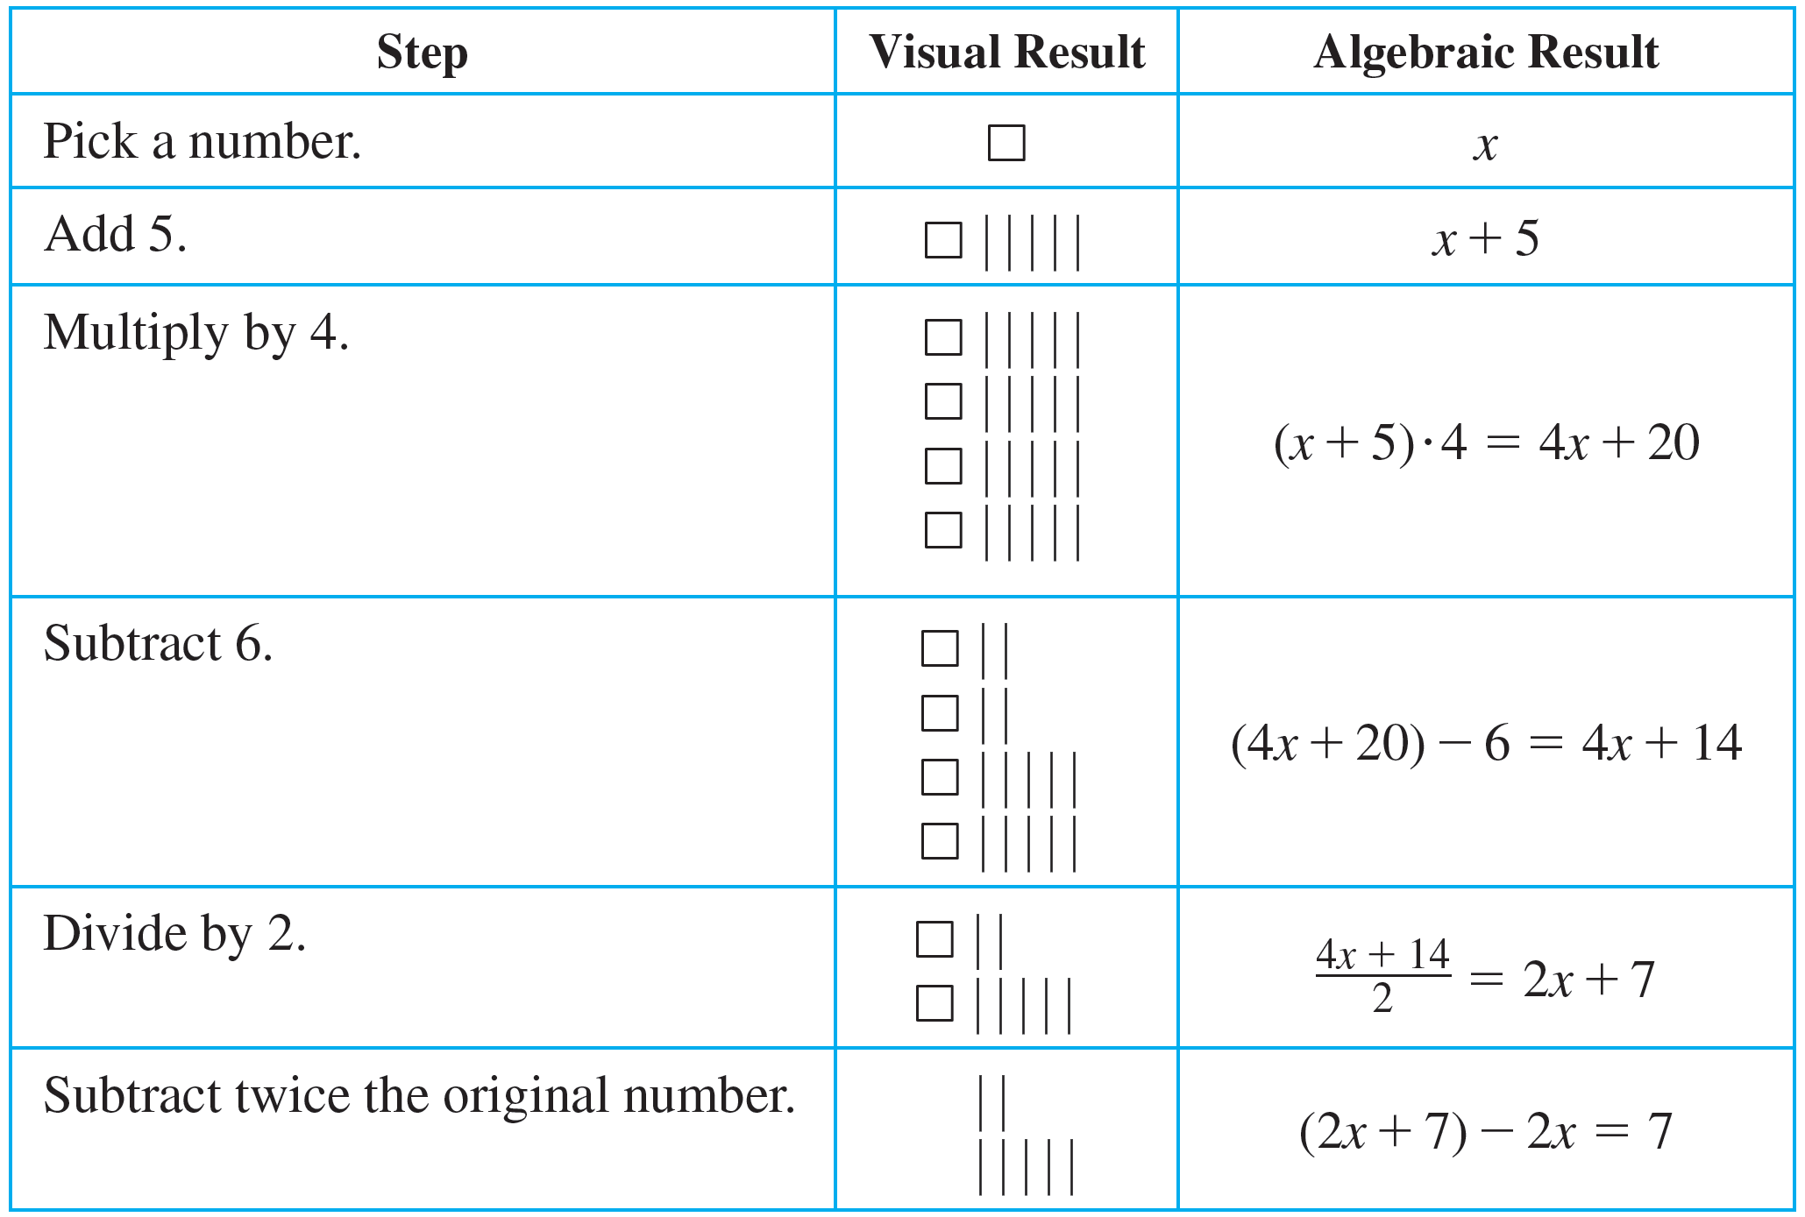
Example 4.1.6 – Generalizing from the Generic Particular
continued
The table shows that by the end of the calculations, whatever was in the empty box was subtracted out of the answer.

Slide 32
Example 4.1.6 – Generalizing from the Generic Particular
continued
The x in the table above is another way of representing the number the person picked. It is particular (because it represents a single quantity), but it is also arbitrarily chosen or generic (because any number whatsoever can be put in its place).
So you can generalize from the generic particular to conclude that if you follow the steps you will always get 7, regardless of the initial value you put in place of x.

Slide 33
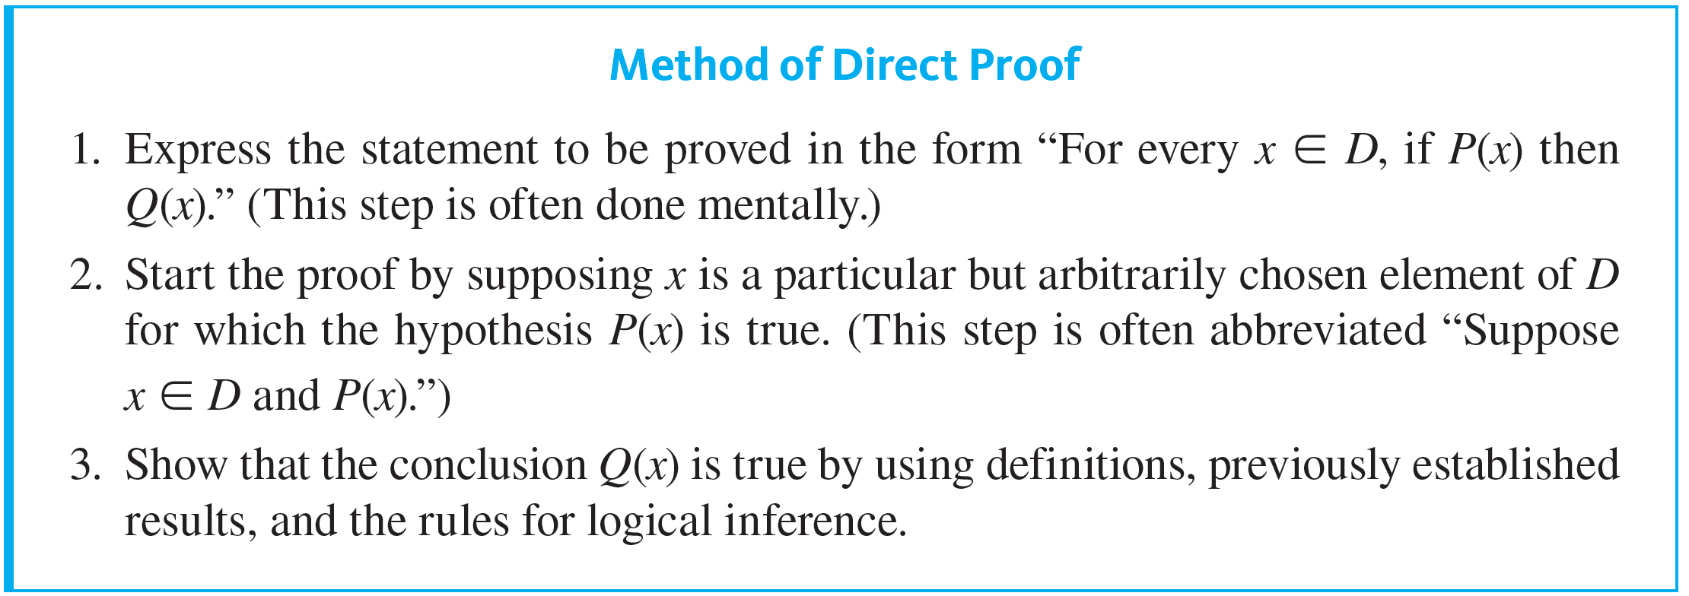
Proving Universal Statements
When the method of generalizing from the generic particular is applied to a property of the form “If P(x) then Q(x),” the result is the method of direct proof.

Slide 34
Example 4.1.7 – A Direct Proof of a Theorem
Prove that the sum of any two even integers is even.

Slide 35
Example 4.1.7 – Solution
Whenever you are presented with a statement to be proved, it is a good idea to ask yourself whether you believe it to be true. In this case you might imagine some pairs of even integers—say 2 + 4, 6 + 10, 12 + 12, 28 + 54—and mentally check that their sums are even.
However, since you cannot possibly check all pairs of even numbers, you cannot know for sure that the statement is true in general by checking its truth in these particular instances. Many properties hold for a large number of examples and yet fail to be true in general.

Slide 36
Example 4.1.7 – Solution
continued
To prove this statement in general, you need to show that no matter what even integers are given, their sum is even.
But given any two even integers, it is possible to represent them as 2r and 2s for some integers r and s.
And by the distributive law of algebra, 2r + 2s = 2(r + s), which is even because r + s is an integer. Thus the statement is true in general.

Slide 37
Example 4.1.7 – Solution
continued
Suppose the statement to be proved is much more complicated than this. What method can you use to derive a proof? You can begin by expressing the statement formally.
Formal Restatement: ∀ integers m and n, if m and n are even then m + n is even.
This statement is universally quantified over an infinite domain. Thus to prove it in general, you need to show that no matter what two integers you might be given, if both of them are even then their sum will also be even.

Slide 38
Example 4.1.7 – Solution
continued
Next ask yourself, “How should I start the proof?” or “What am I supposing?” The answer to such a question gives you the starting point, or first sentence, of the proof.
Starting Point: Suppose m and n are any particular but arbitrarily chosen integers that are even.
Or, in abbreviated form:
Suppose m and n are any even integers.
Then ask yourself, “What conclusion do I need to show in order to complete the proof?”

Slide 39
Example 4.1.7 – Solution
continued
To Show: m + n is even.
Since both involve the term even integer, you must use the definition of this term—and thus you must know what it means for an integer to be even.
It follows from the definition that since m and n are even, each equals twice some integer.

Slide 40
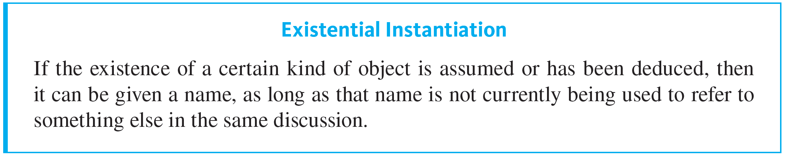
Example 4.1.7 – Solution
continued
One of the basic laws of logic, called existential instantiation, says, in effect, that if you know something exists, you can give it a name. However, you cannot use the same name to refer to two different things, both of which are currently under discussion.

Slide 41

Example 4.1.7 – Solution
continued

Slide 42
Getting Proofs Started

Slide 43
Getting Proofs Started
Believe it or not, once you understand the idea of generalizing from the generic particular and the method of direct proof, you can write the beginnings of proofs even for theorems you do not understand.
The reason is that the starting point and what is to be shown in a proof depend only on the linguistic form of the statement to be proved, not on the content of the statement.

Slide 44
Example 4.1.8 – Identifying the “Starting Point” and the “Conclusion to Be Shown”
Write the first sentence of a proof (the “starting point”) and the last sentence of a proof (the “conclusion to be shown”) for the following statement:
Every complete bipartite graph is connected.

Slide 45
Example 4.1.8 – Solution
It is helpful to rewrite the statement formally using a quantifier and a variable:
The first sentence, or starting point, of a proof supposes the existence of an object (in this case G) in the domain (in this case the set of all graphs) that satisfies the hypothesis of the if-then part of the statement (in this case that G is complete bipartite). The conclusion to be shown is just the conclusion of the if-then part of the statement (in this case that G is connected).

Slide 46
Example 4.1.8 – Solution
continued
Starting Point: Suppose G is a [particular but arbitrarily chosen] graph such that G is complete bipartite.
Conclusion to Be Shown: G is connected.
Thus the proof has the following shape:
Proof:
Suppose G is a [particular but arbitrarily chosen] graph such that G is complete bipartite.
⋮
Therefore, G is connected.

Slide 47

Example 4.1.9 – Fill in the Blanks for a Proof
Fill in the blanks in the proof of the following theorem.
Theorem: For all integers r and s, if r is even and s is odd then 3r + 2s is even.
Proof: Suppose r and s are any [particular but arbitrarily chosen] integers such that r is even and s is odd.
[We must show that 3r + 2s is even.]
By
and s = 2n + 1 for some integers m and n.

Slide 48


Example 4.1.9 – Fill in the Blanks for a Proof
continued
Then
3r + 2s = 3(2m) + 2(2n + 1)
= 6m + 4n + 2
by multiplying out
= 2(3m + 2n + 1)
by factoring out 2
Let t = 3m + 2n + 1.
Then t is an integer because m, n, 3, 2, and 1 are integers and because

Slide 49

Example 4.1.9 – Solution
Hence 3r + 2s = 2t, where t is an integer, and so by
3r + 2s is even [as was to be shown].
(a) definition of even and odd, (b) substitution, (c) products and sums of integers are integers, (d) definition of even.

